Slide 1
Object Oriented Programming With C++
By: E Balagurusamy

Slide 2
Procedure Oriented Programming (POP) V/S Object Oriented Programming (OOP)
 | POP | OOP
Divided Into | Functions | Objects
Importance | Functions | Data
Approach | Top-down | Bottom up
Access Specifiers | No | Yes (Private, Public etc.)
Data | Can move freely | Objects can move and communicate
Moving | Function to Function | Objects can move through member functions
Expansion | Adding data is not easy | Adding data is easy
Data Access | Use global data for sharing | Data can not be move easily. Controlled by Access specifiers
Data Hiding | Does not have proper way of hiding | Provides Data hiding
Overloading | No | Yes

Slide 3
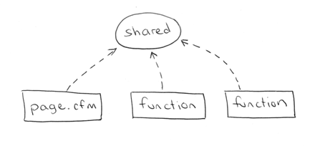
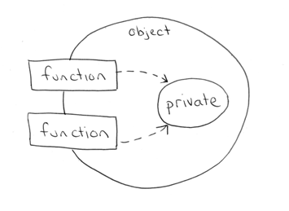
OBJECT ORIENTED PROGRAMMING
PROCEDURAL PROGRAMMING

Slide 4
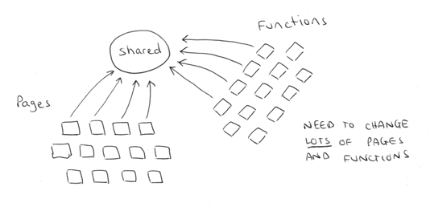
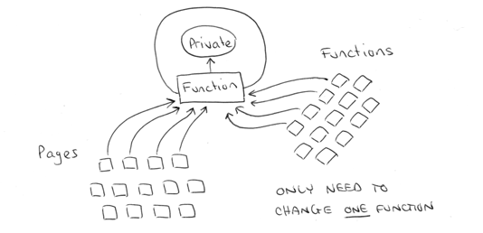
OBJECT ORIENTED PROGRAMMING
PROCEDURAL PROGRAMMING

Slide 5
OBJECT ORIENTED PROGRAMMING
Object 1
Object 2
Data
Data
Function
Function
Object 3
Data
Function

Slide 6
OBJECT ORIENTED PROGRAMMING
Objects have both data and methods
Objects of the same class have the same data elements and methods
Objects send and receive messages to invoke actions
Key idea in object-oriented:
The real world can be accurately described as a collection of objects that interact.

Slide 7
Basic terminology
object
- usually a person, place or thing (a noun)
method
- an action performed by an object (a verb)
attribute
- description of objects in a class
class
- a category of similar objects (such as automobiles)
- does not hold any values of the object’s attributes

Slide 8
Example for attributes and methods
Attributes:
manufacturer’s name
model name
year made
color
number of doors
size of engine
etc.
Methods:
Define data items (specify manufacturer’s name, model, year, etc.)
Change a data item (color, engine, etc.)
Display data items
Calculate cost
etc.

Slide 9
Why OOP?
Save development time (and cost) by reusing code
once an object class is created it can be used in other applications
Easier debugging
classes can be tested independently
reused objects have already been tested

Slide 10
Design Principles of OOP
Four main design principles of Object-Oriented Programming(OOP):
Encapsulation
Abstraction
Polymorphism
Inheritance

Slide 11

Encapsulation
Also known as data hiding
Only object’s methods can modify information in the object.
Analogy:
ATM machine can only update accounts of one person or object only.

Slide 12
Abstraction
Focus only on the important facts about the problem at hand
to design, produce, and describe so that it can be easily used without knowing the details of how it works.
Analogy:
When you drive a car, you don’t have to know how the gasoline and air are mixed and ignited.
Instead you only have to know how to use the controls.
Draw map

Slide 13
Polymorphism
the same word or phrase can mean different things in different contexts
Analogy:
In English, bank can mean side of a river or a place to put money

Slide 14
Function Overloading
The operation of one function depends on the argument passed to it.
Example: Fly(), Fly(low), Fly(150)

Slide 15
Inheritance
Inheritance—a way of organizing classes
Term comes from inheritance of traits like eye color, hair color, and so on.
Classes with properties in common can be grouped so that their common properties are only defined once.
Superclass – inherit its attributes & methods to the subclass(es).
Subclass – can inherit all its superclass attributes & methods besides having its own unique attributes & methods.

Slide 16
An Inheritance Hierarchy
Superclass
Vehicle
Subclasses
Automobile
Motorcycle
Bus
Sedan
Sports Car
Luxury Bus
School Bus
What properties does each vehicle inherit from the types of vehicles above it in the diagram?

Slide 17
Object-Oriented Programming Languages
• Pure OO Languages
Smalltalk, Java
• Hybrid OO Languages
C++, Objective-C, Object-Pascal

Slide 18
Introduction
C++ is the C programmer’s answer to Object-Oriented Programming (OOP).
C++ is an enhanced version of the C language.
C++ adds support for OOP without sacrificing any of C’s power, elegance, or flexibility.
C++ was invented in 1979 by Bjarne Stroustrup at Bell Laboratories in Murray Hill, New Jersey, USA.

Slide 19
Classes and Objects
A class is a data type that allows programmers to create objects. A class provides a definition for an object, describing an object’s attributes (data) and methods (operations).
An object is an instance of a class. With one class, you can have as many objects as required.
This is analogous to a variable and a data type, the class is the data type and the object is the variable.
Notes:
Write a program is the same as solving other problems – the steps are the same, only the product is different.

Slide 20
Two Versions of C++
A traditional-style C++ program -
#include <iostream.h> int main() { /* program code */ return 0; }

Slide 21
Two Versions of C++ (cont.)
A modern-style C++ program that uses the new-style headers and a namespace -
#include <iostream> using namespace std; int main() { /* program code */ return 0; }

Slide 22
Namespaces
A namespace is a declarative region.
It localizes the names of identifiers to avoid name collisions.
The contents of new-style headers are placed in the std namespace.
A newly created class, function or global variable can put in an existing namespace, a new namespace, or it may not be associated with any namespace

Slide 23
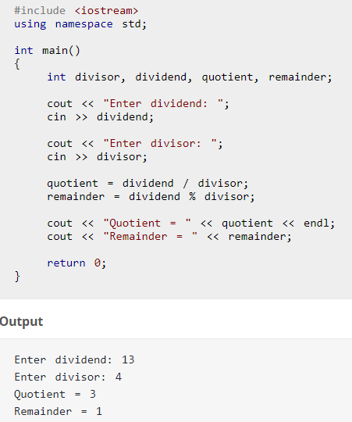
C++ Program

Slide 24
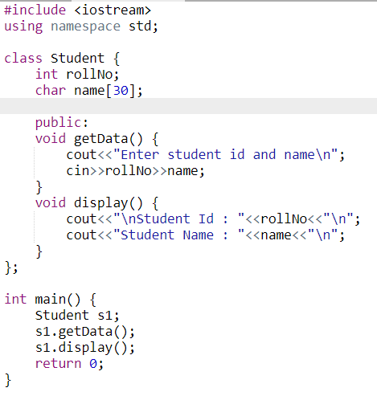
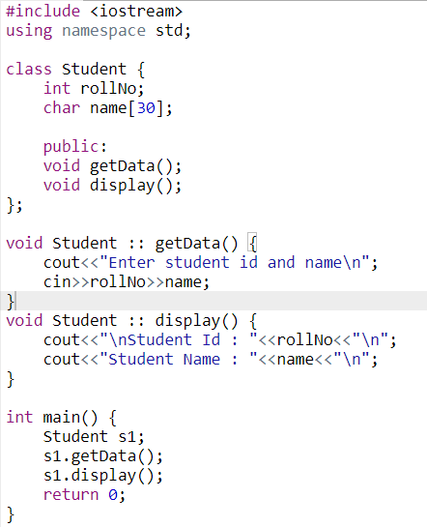
C++ Program

